Slide 1
Artificial Intelligence and Machine Learning for OEMs
Supply Chain Optimization with AI & ML
By: Makarand Hinge
Date: 17-11-2024

Slide 2
Tech Stack Overview
Frontend:
React Native for building a user-friendly interface for OEM managers and operators.
Backend:
Python (for AI & ML models using PyTorch and Scikit-learn).
Java for additional backend services or integrations.
Frameworks:
Flask for the Python-based backend to serve AI/ML models.
Spring Boot (Java) for other backend services and API management.
Database:
SQL for structured data (inventory, sales history, etc.).
NoSQL for unstructured or flexible data (supplier evaluations, route logs).
AI/ML:
PyTorch and Scikit-learn for training and deploying machine learning models.
Source:
Kaggle

Slide 3
How the Project Works (Overview)
Data Collection:
Collects real-time data from multiple sources:
Sales data, market trends, inventory data, traffic patterns, etc.
Data is cleaned and processed for analysis and model training.
AI/ML Models:
Demand Forecasting: Uses historical data to predict future demand.
Inventory Optimization: ML models predict stock needs, reorder points.
Route Optimization: AI models determine the most efficient delivery routes.
Supplier Risk Assessment: ML models assess risk based on performance and external factors.

Slide 4
Data Flow and Integration
Frontend (React): Displays forecasts, alerts, and reports to the user.
Backend (Flask + Spring Boot): Communicates with the frontend via REST APIs.
Integrates AI/ML models into the backend for real-time predictions.
Databases (SQL + NoSQL): Stores structured and unstructured data for real-time analytics.

Slide 5
Frontend (React)
UI Features:
Easy-to-use dashboard to track forecasts, inventory, and delivery status.
Alerts and notifications for out-of-stock items or delivery delays.
Allows users to input data like product details, pincode, and order information.
Technologies Used:
React Native for cross-platform compatibility (iOS and Android).
API integration with the backend to fetch real-time data.
Real-time updates on delivery, inventory, and demand forecasting.

Slide 6
Backend (Python + Flask + Java + Spring)
Flask (Python): Hosts machine learning models for demand forecasting and inventory optimization.
Flask API endpoints allow the frontend to fetch predictions and recommendations.
Spring Boot (Java): Manages business logic and APIs for supplier risk assessment and routing.
Handles data persistence, querying SQL/NoSQL databases.
Provides a robust framework for API and microservices-based architecture.

Slide 7
AI/ML Models (PyTorch + Scikit-learn)
Demand Forecasting:
Uses time series analysis to predict future demand.
Models are trained using historical data and updated periodically.
Inventory Management:
Machine learning algorithms like regression or classification help predict stock levels and reorder points.
Route Optimization:
Uses AI to suggest the most efficient routes based on factors like traffic, delivery windows, and vehicle capacity.
Supplier Risk Assessment:
ML models assess supplier data (e.g., financial health, past performance) and predict potential risks.

Slide 8
Database (SQL + NoSQL)
SQL Database:
Stores structured data such as inventory levels, historical sales data, etc.
Ensures ACID (Atomicity, Consistency, Isolation, Durability) properties for transaction management.
NoSQL Database:
Stores unstructured or semi-structured data, like supplier risk factors, delivery logs, and customer data.
Enables fast and flexible data retrieval for AI/ML models and real-time analytics.

Slide 9
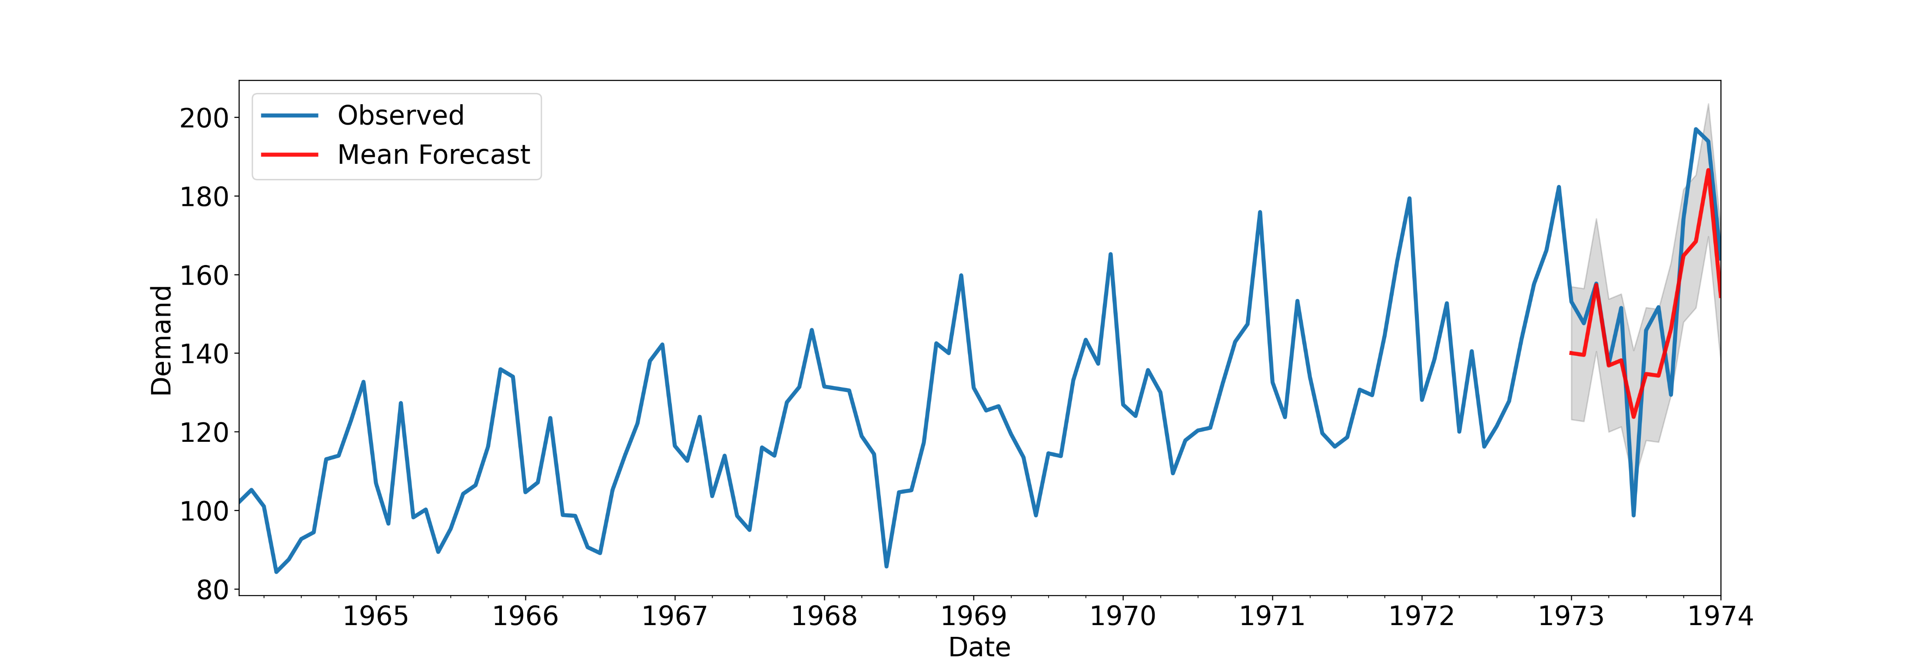
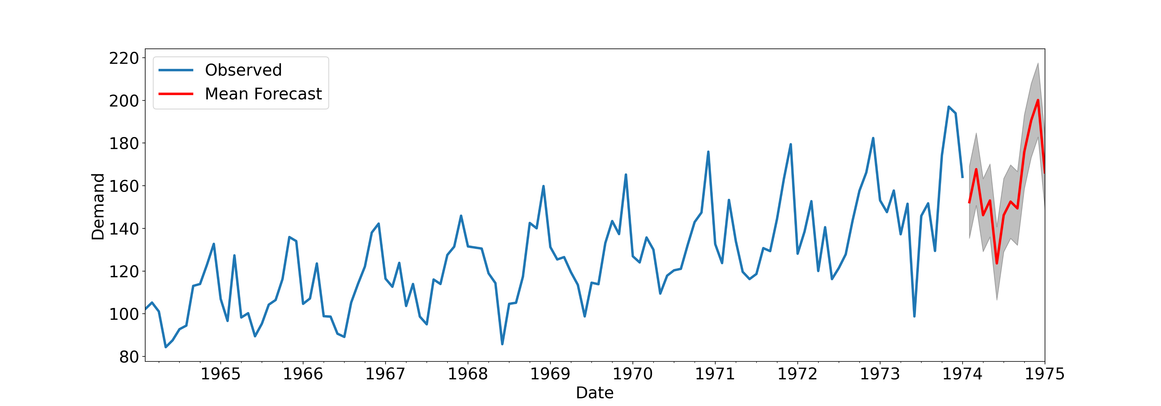
Screenshot

Slide 10
Next Step and Conclusion
Next Steps:
Inventory Module: Begin working on the inventory optimization module, leveraging AI & ML models to predict stock needs, reorder points, and manage inventory more efficiently.
Simultaneous Development: Work on other key modules (e.g., route optimization, supplier risk assessment) alongside the inventory module to ensure smooth integration with the overall system.
Integration: Integrate the demand forecasting module with the inventory and other modules to create a seamless, optimized supply chain management solution.
Conclusion:
The Demand Forecasting Module is now complete, providing accurate predictions that help optimize supply chain operations.
With the successful implementation of this module, the next steps involve parallel development of the Inventory, Route Optimization, and Supplier Risk Assessment modules.
The project will continue to evolve with further refinements and integrations, helping OEMs streamline their operations and reduce costs through cutting-edge AI & ML technologies.

